Slide 1

Java introduction

Slide 2
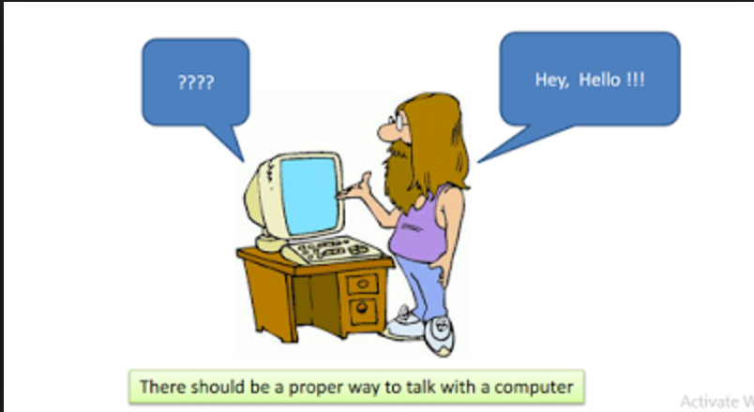
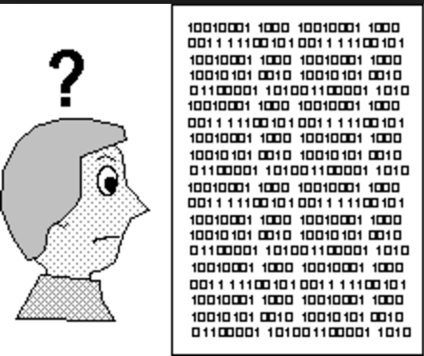

human interaction with computers
Computers only understand one language: machine language: 01011101. Binary

Slide 3
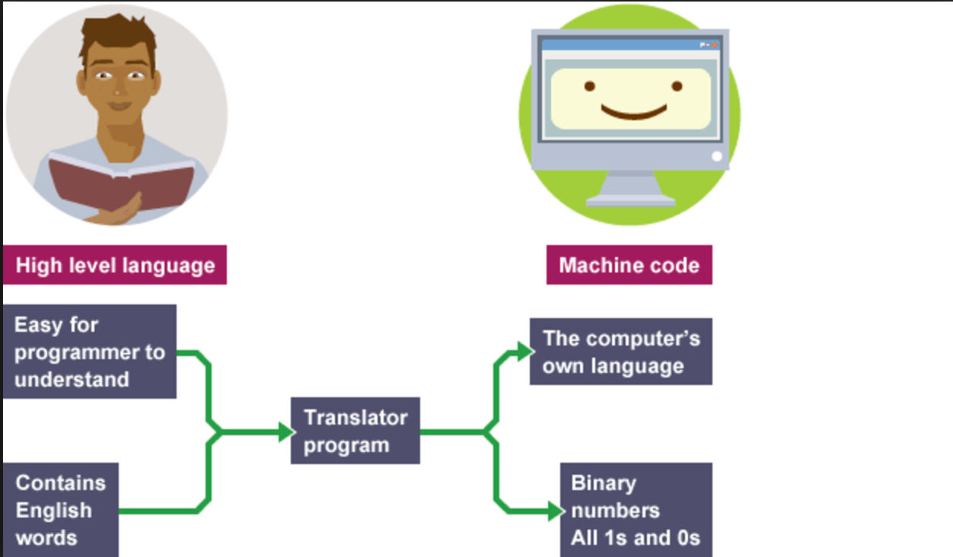
why we need program ?? or programming language?
Program: A set of instructions that are to be carried out by a computer.
Programming language:
A systematic set of rules used to describe computations, generally in a format that is editable by humans.
Forms a bridge between humans and machines (computers).

Slide 4
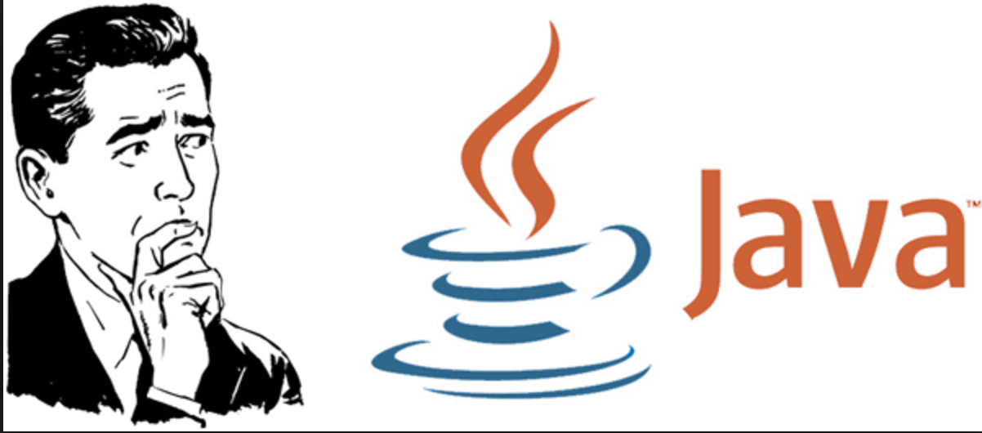
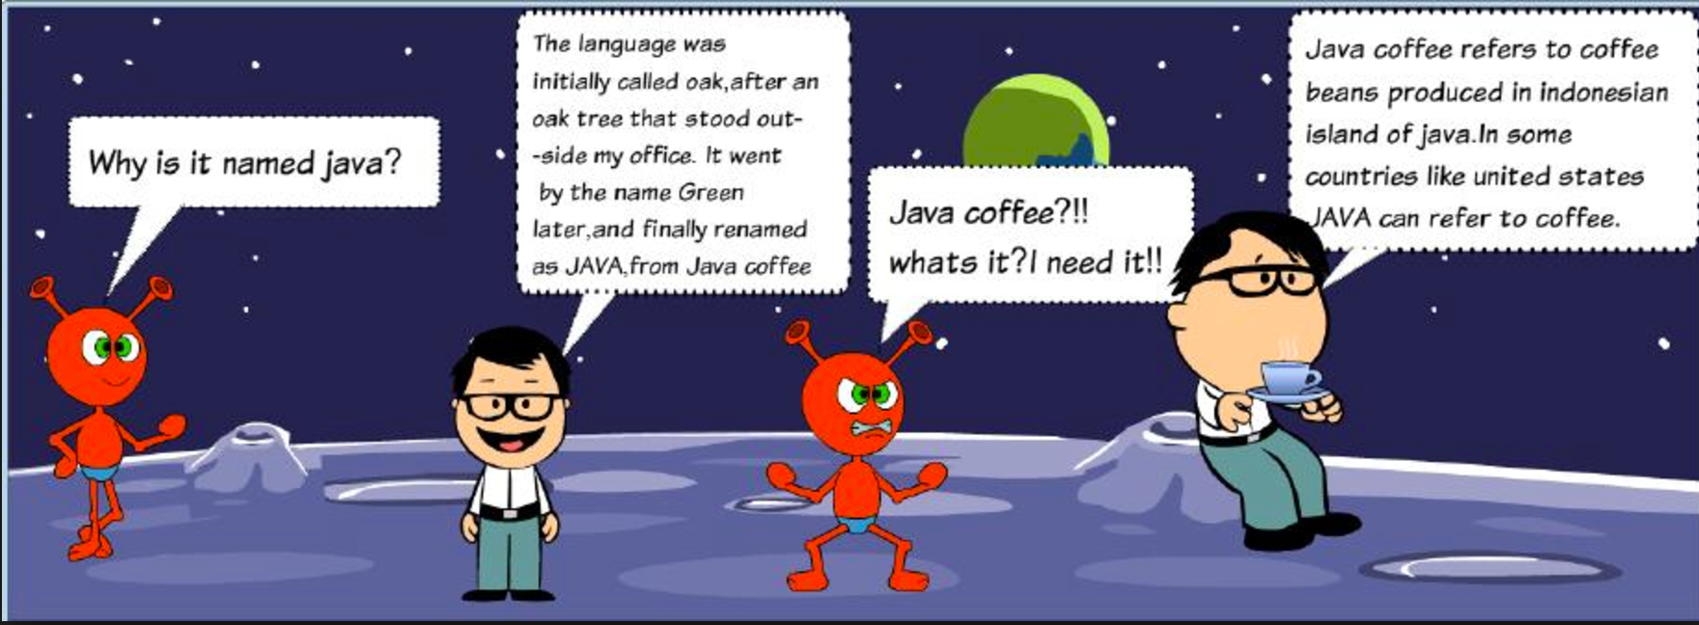
what is Java?
Is one of most popular software programming language.
Is used not only for Web programming, but also for developing standalone applications across platforms on servers, desktops, and mobile devices, even control the robotic rover that rolled on Mars.
Is a high level programming language.
Developed by Sun Microsystems Inc in 1991, later acquired by Oracle Corporation. It was conceived by James Gosling and Patrick Naughton.

Slide 5
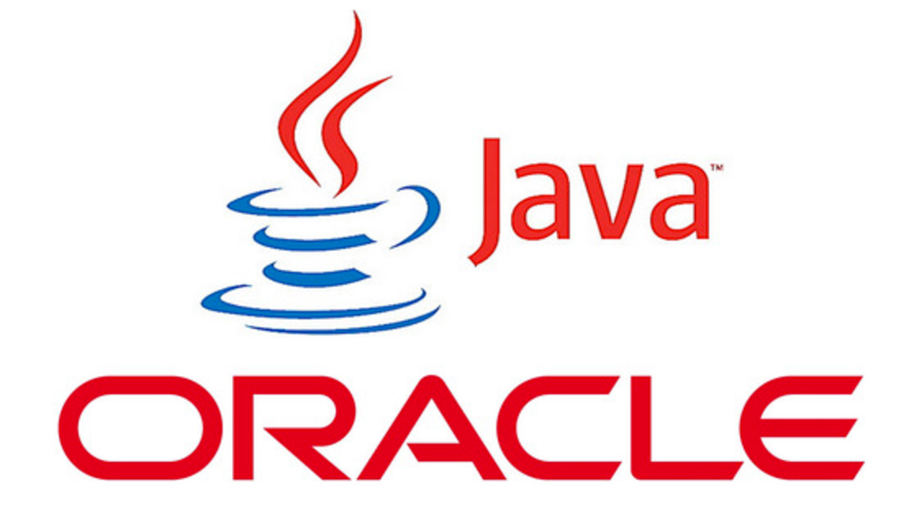

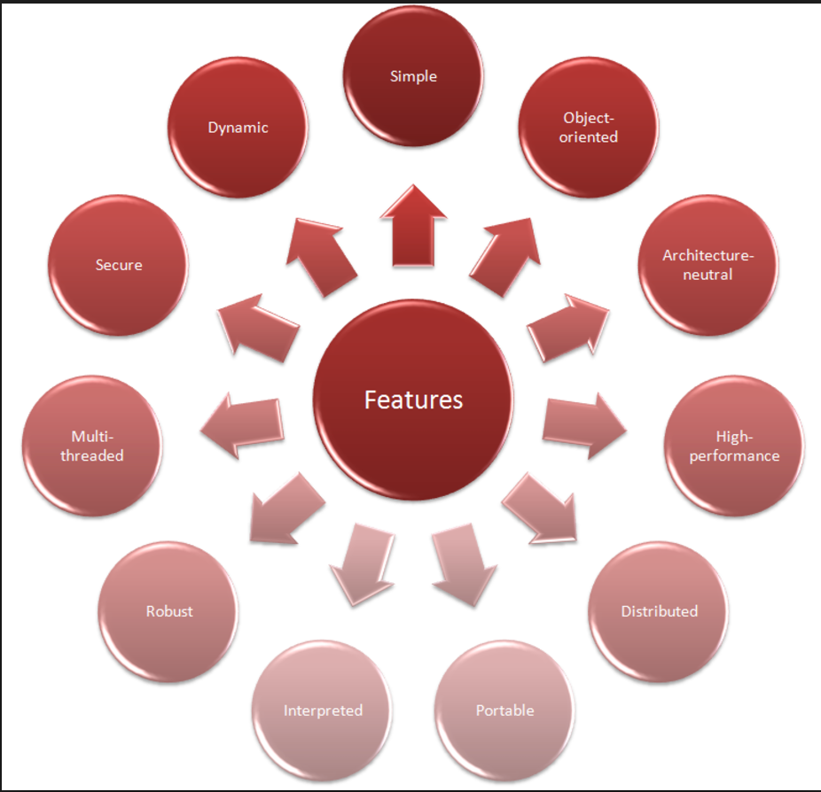
Features of java

Slide 6
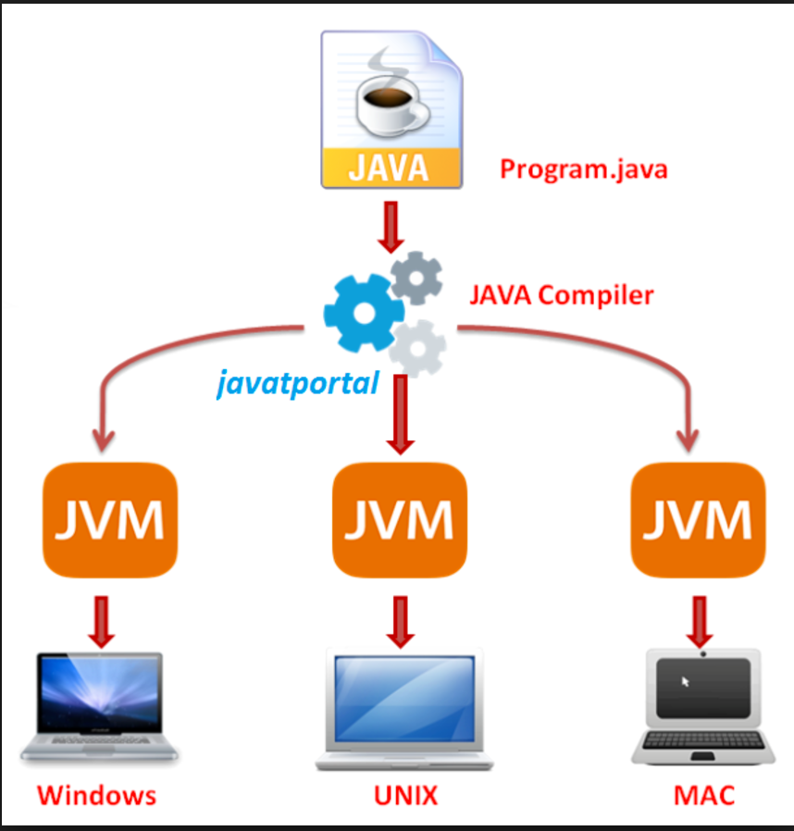
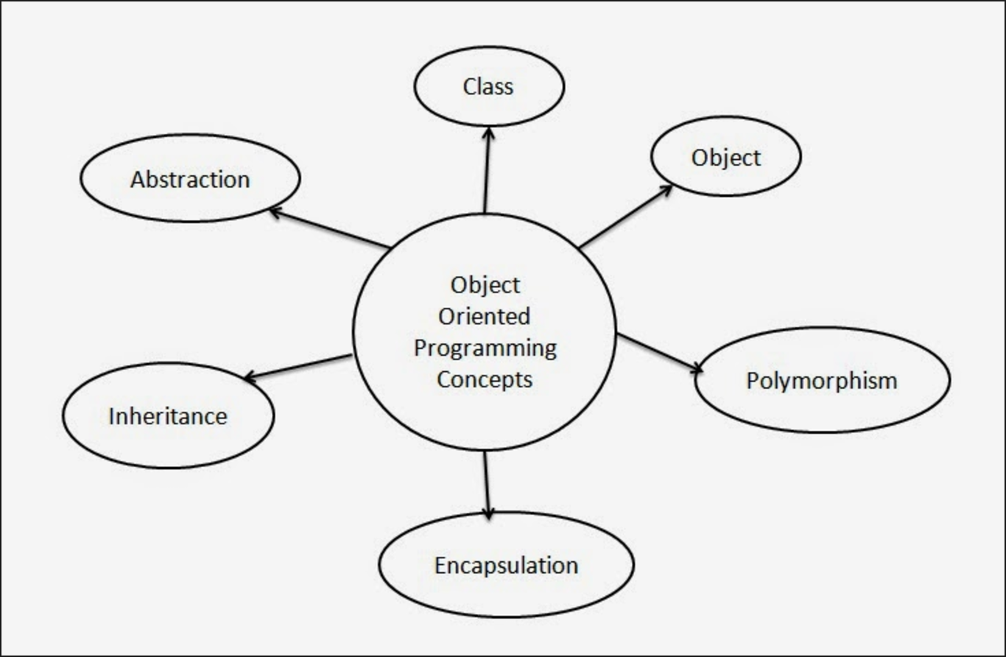
Java is Platform Independent
Java is Object Oriented Programming Language

Slide 7
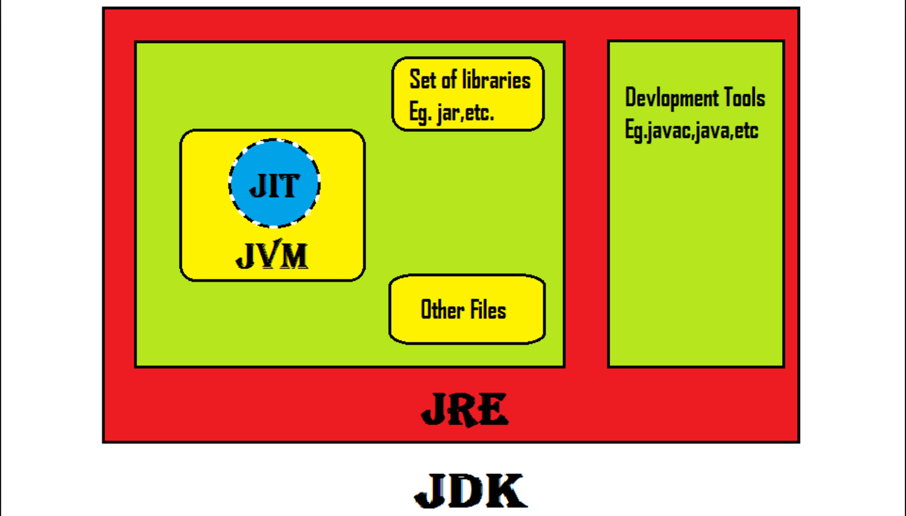

java architecture
JDK (Java Development Kit)
It is used to build and develop the java program
JDK=JRE + Java complier + other developing related tools
JRE (Java Runtime Environment )
It is used to provide runtime environment.It is the implementation of JVM. It contains set of libraries + other files that JVM uses at runtime.
JRE= JVM + Class libraries + JIT complier + other supporting tools
JVM :JVM (Java Virtual Machine) is an abstract machine. It is a specification that provides runtime environment in which java bytecode can be executed.

Slide 8
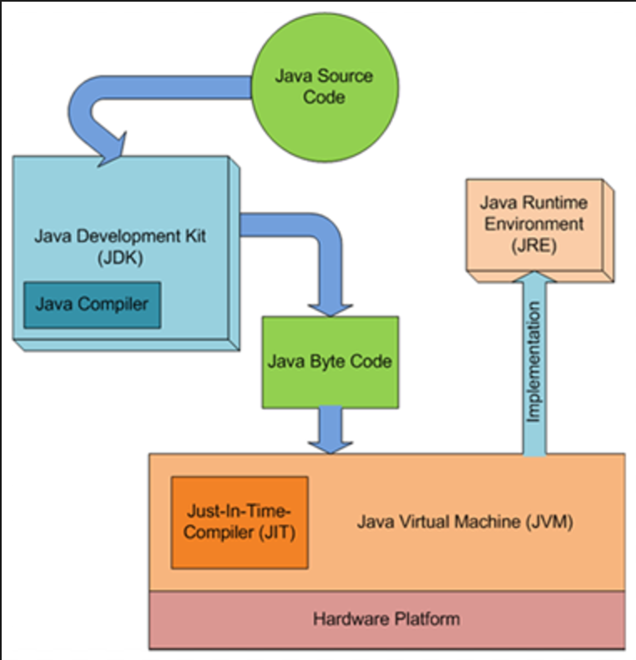
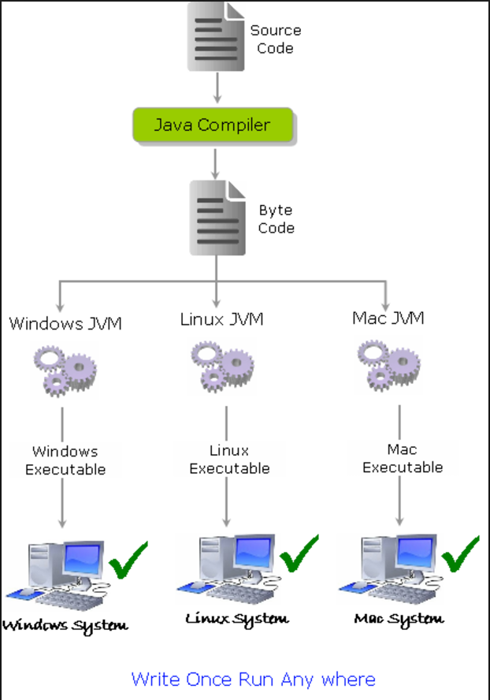
how java works?

Slide 9
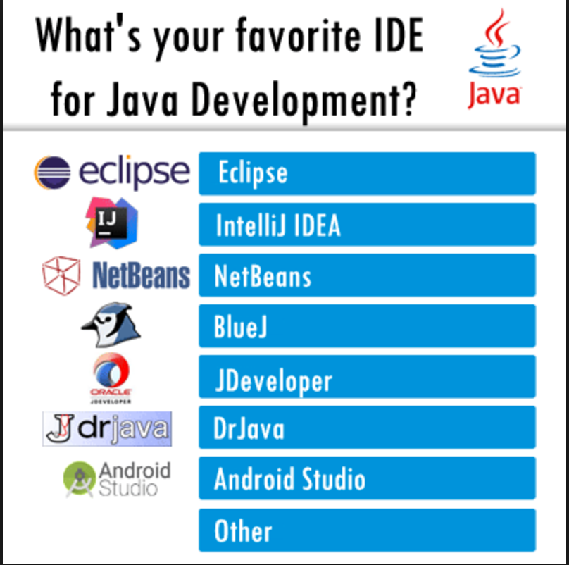

what is ide? (integrated Development environment)

Slide 10
java program basic components
When we consider a Java program, it can be defined as a collection of objects that communicate via invoking each other's methods.
Let us now briefly look into what do class, object, methods, and instance variables mean.
Object − Objects have states and behaviours. Example: A dog has states - colour, name, breed as well as behaviour such as wagging their tail, barking, eating. An object is an instance of a class.
Class − A class can be defined as a template/blueprint that describes the behaviour/state that the object of its type supports.
Variables − Each object has its unique set of instance variables. An object's state is created by the values assigned to these instance variables.
Methods − A method is basically a behaviour. A class can contain many methods. It is in methods where the logics are written, data is manipulated and all the actions are executed.

Slide 11
java anatomy
Comments
Package
Reserved words/Keywords
Identifiers
Modifiers
Variables
Statements
Blocks/Areas of the class
Classes
Methods
The main method
http://www.javatpoint.com/java-tutorial
http://www.tutorialspoint.com/java/

Slide 12
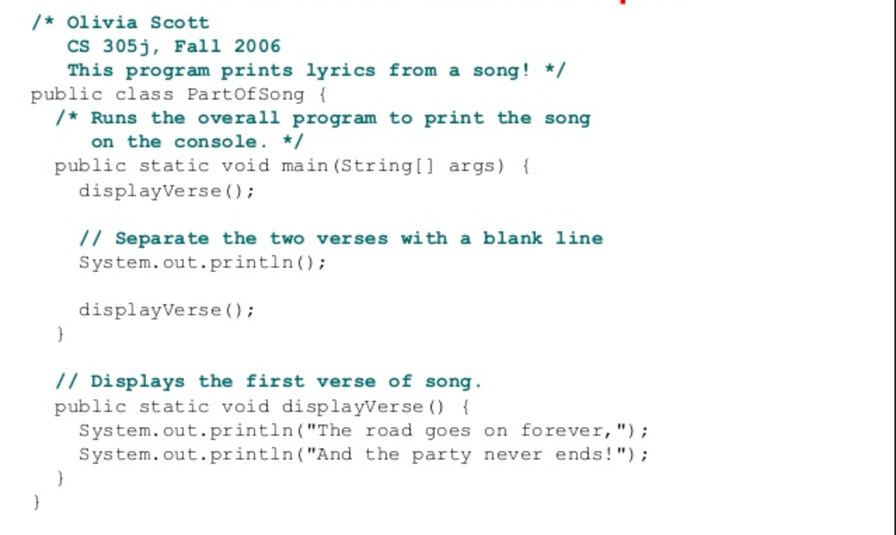
comments in java
Comments in a program are called inline documentation
Normally used to explain the purpose of the program, describe processing steps - imp for human understanding. Not affect how a program works -java complier ignores comments
Java comments can take three forms:
// this comment runs to the end of the line
/* this comment runs to the terminating symbol, even across line breaks */
*//** this is a javadoc comment */

Slide 13
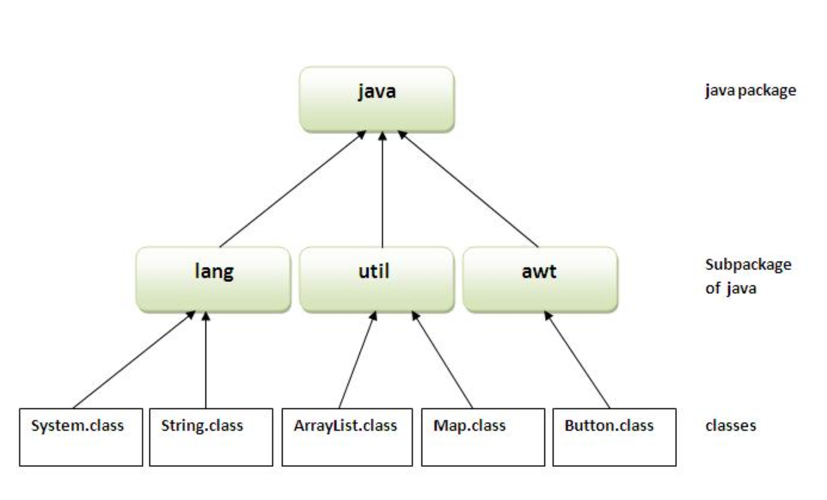
java Package
A java package is a group of similar types of classes, interfaces and sub-packages.
Package in java can be categorised in two form, built-in package and user-defined package.
There are many built-in packages such as java, lang, awt, javax, swing, net, io, util, sql etc.
Advantage of Java Package
1) Java package is used to categorise the classes and interfaces so that
they can be easily maintained.
2) Java package provides access
protection.

Slide 14
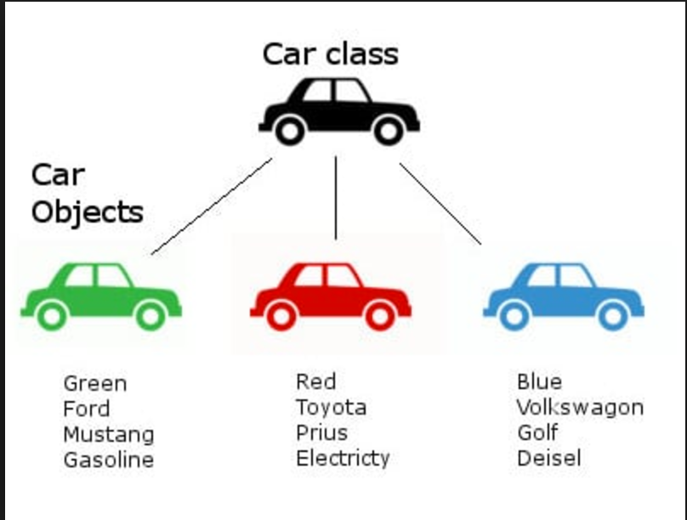
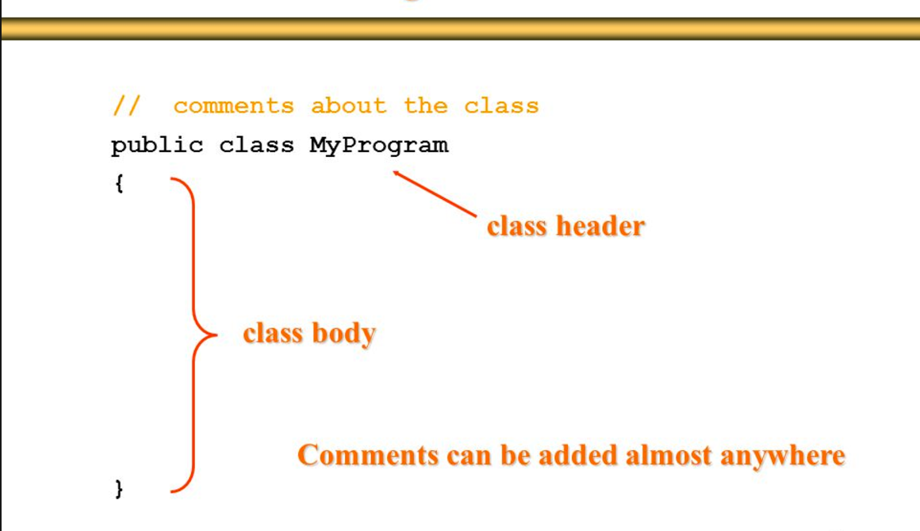
What is class in java ?
A blueprint or a template for creating different objects which defines its properties and behaviours.
A class is a group of objects which have
common properties. It is a logical entity.
Every java Program has at least one class
A class in Java can contain:
fields/variables
methods
constructors
blocks/areas
nested class and interface

Slide 15
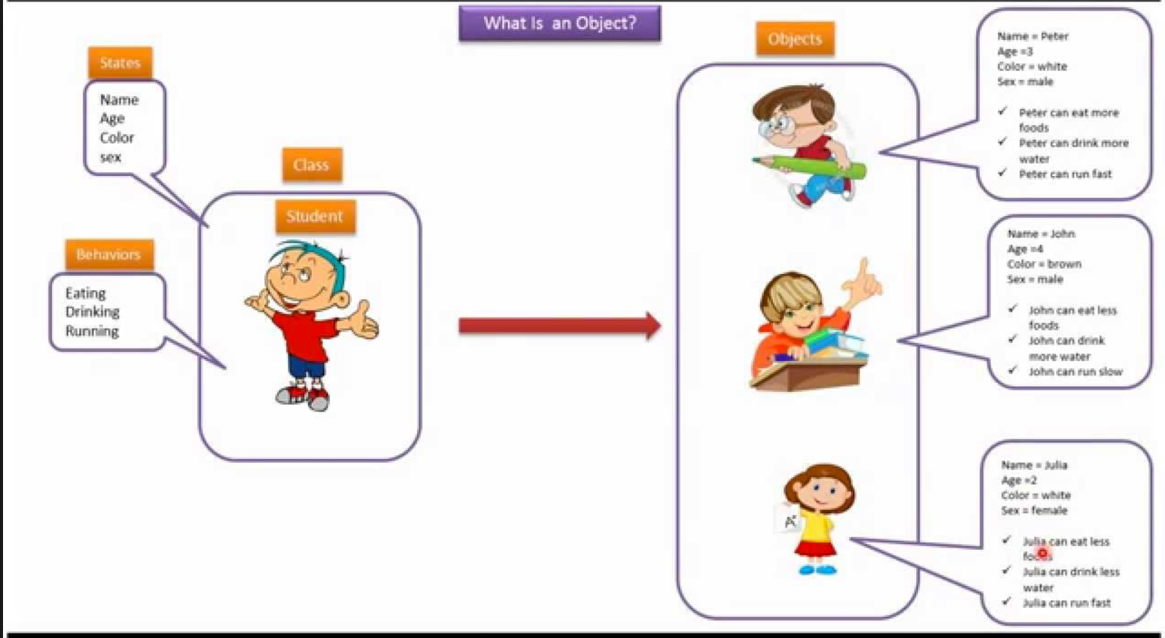
what is object?
Object is an instance of a class. It is a real world entity. Object is a run time entity. Class is a template or blueprint from which objects are created. So object is the instance(result) of a class.
An object (A dog) has:
state - descriptive characteristics - like colour, name, breed
behaviours - what it can do (or what can be done to it) - like wrapping the tail, barking, eating

Slide 16
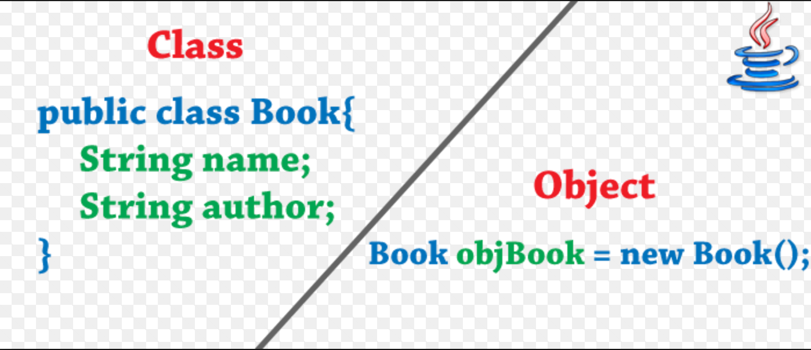
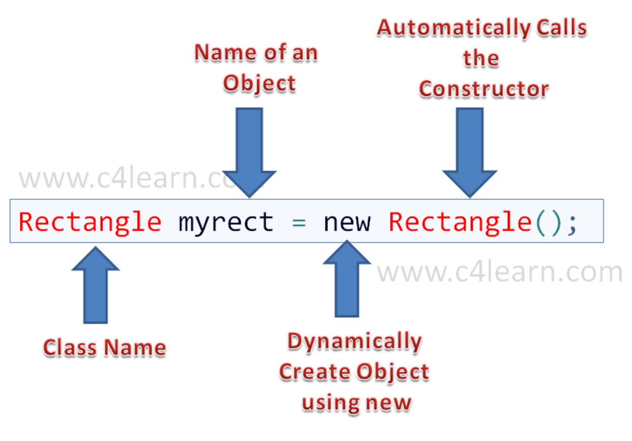
how to declare object?

Slide 17
modifiers in java
Modifiers are keywords that you add to those definitions to change their meanings.
Java language has a wide variety of modifiers, including the following −
Java Access Modifiers
Non Access Modifiers
Java provides a number of access modifiers to set access levels for classes, variables, methods, and constructors. The four access levels are −
1. Visible to the package, the (default). No modifiers are needed.
2. Visible to the class only (private).
3. Visible to the world (public).
4. Visible to the package and all subclasses (protected).

Slide 18
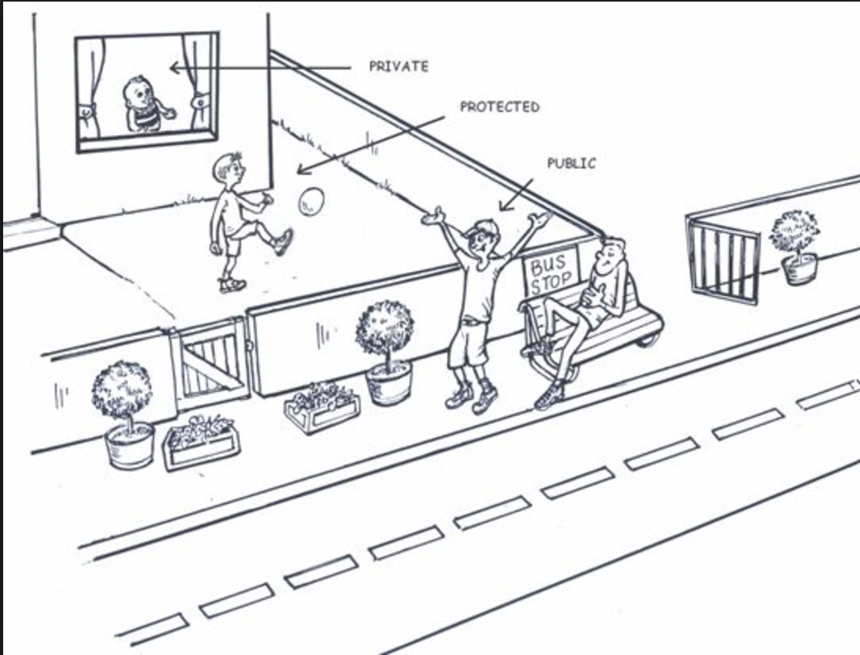
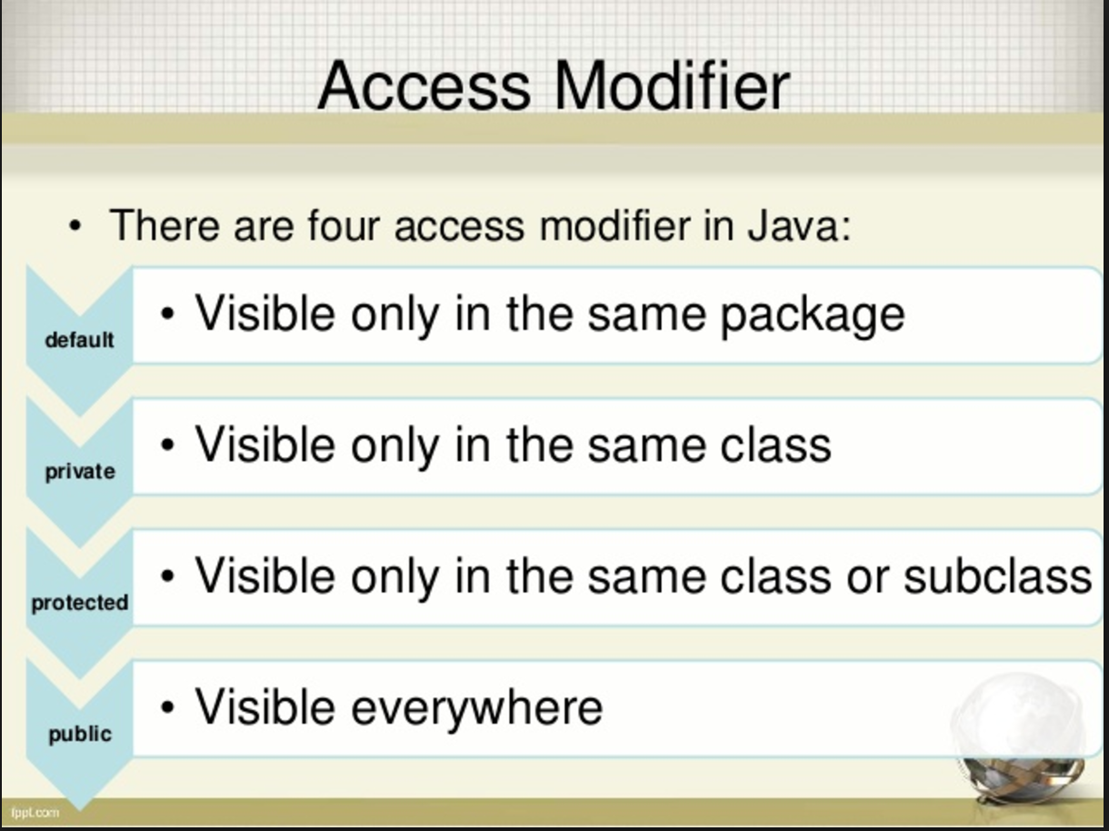
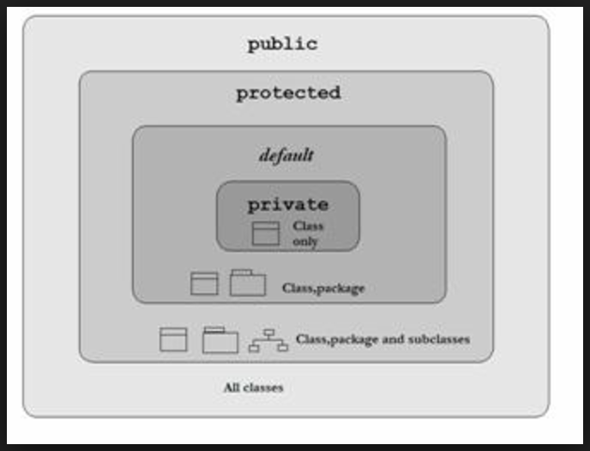
access modifiers

Slide 19
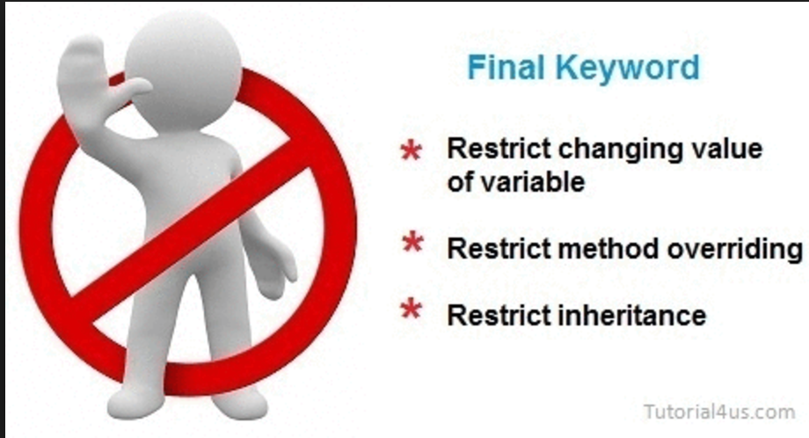
non access modifiers
static :
is used to create variables, method that will exist independently of any instances created for the class.
Only one copy of the static variable exists regardless of the number of instances of the class.
final :
for finalising the implementations of classes, methods, and variables.
A final variable can be explicitly initialised only once.
A reference variable declared final can never be reassigned to
refer to an different object.
(final modifier often is used with static
to make the variable constant).
3. abstract:
modifier for creating abstract classes and methods.
An abstract class can never be instantiated.
If a class is declared as abstract then the sole purpose is for the class to be extended.
A class cannot be both abstract and final

Slide 20
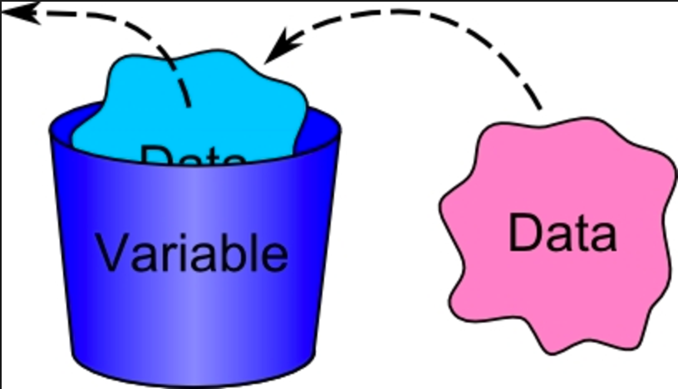
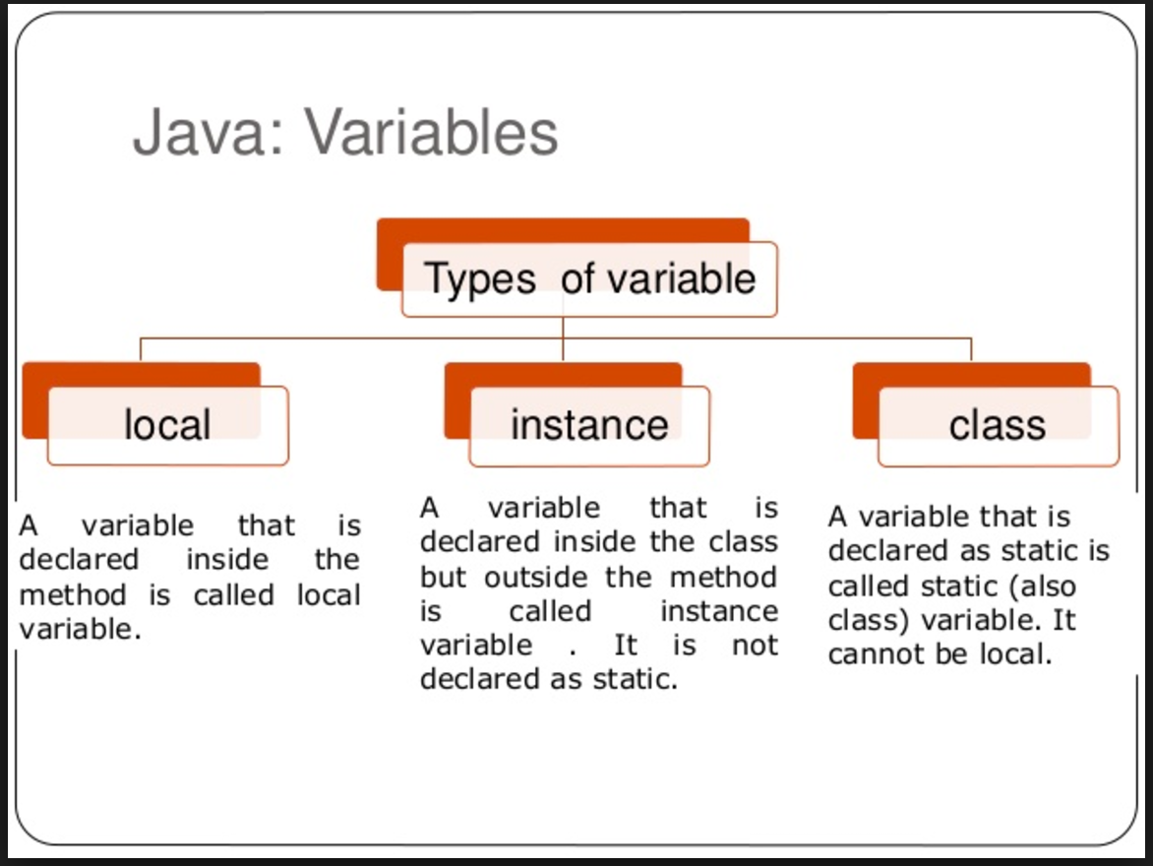
java variable
Variables are nothing but reserved memory locations to store data values, by using this values we are achieving the project requirements. This can be any kind of information ranging from texts, numbers, sentences, etc.
This means that when you create a variable you reserve some space in the memory. A variable thus has a data type.
In simple words we can say variables are containers that holds the data.
Types of Variable:

Slide 21
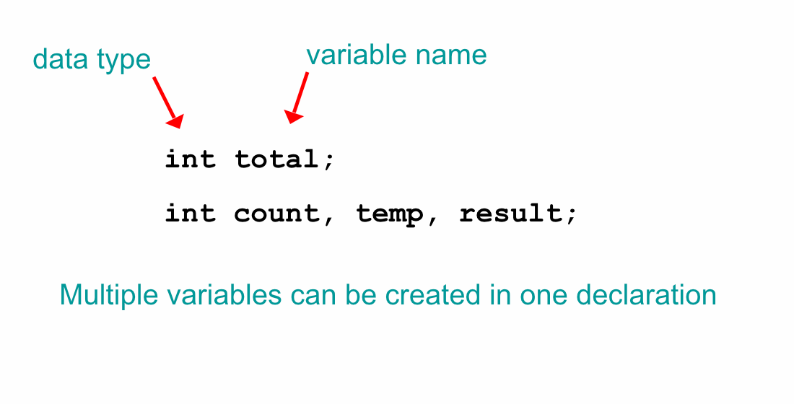
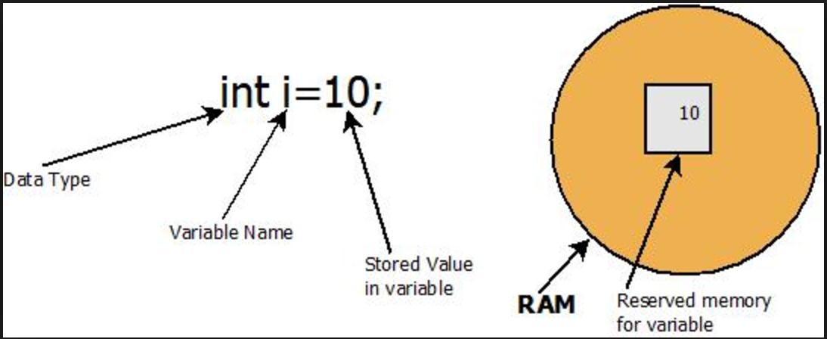
variable declaration and initialisation
A variable must be declared by specifying the variable's name and the type of information that it will hold
When we assign a value to variable
called - variable initialisation
When a variable is referenced in a
program (by variable name),
its current value is used

Slide 22
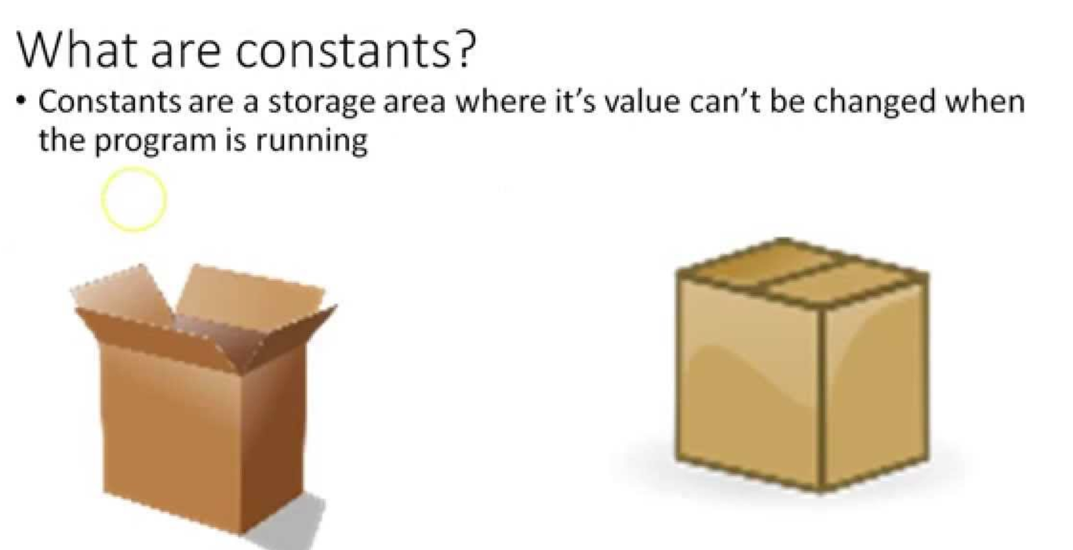
constants
Constants in java refers to the fixed values, which do not change during execution of the program.
A static final variable is effectively a constant.
Java constants are normally declared in ALL CAPS. Words in Java constants are normally separated by underscores.
An example of constant declaration in Java is written below:
public class MaxUnits {
public static final int MAX_UNITS = 25;
static final double SALES_TAX_RATE = 0.85;
}

Slide 23
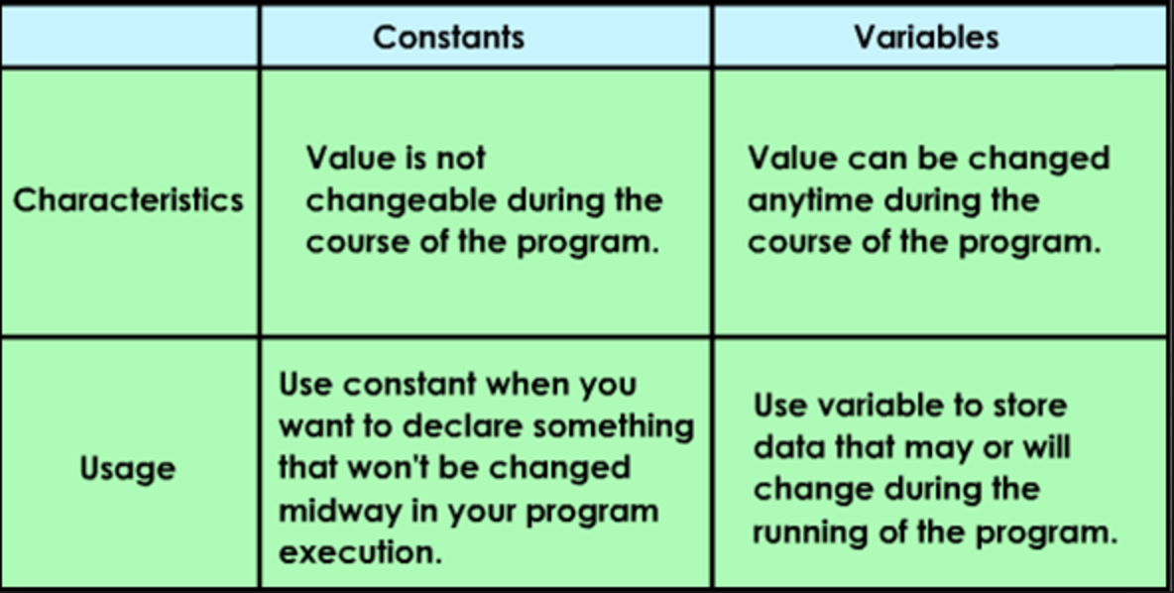
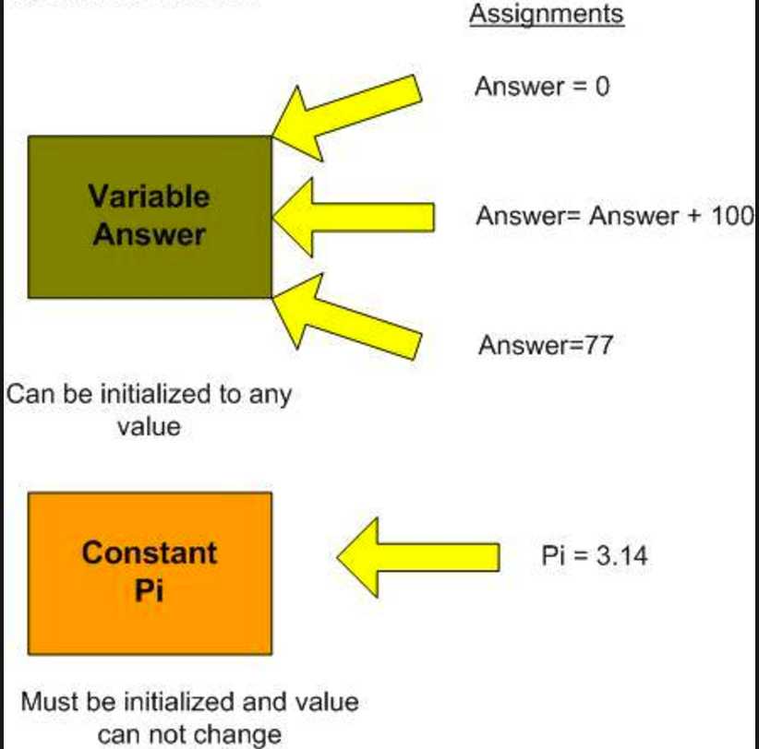
constants Vs variables

Slide 24
identifiers in java
The name given to a variable, method, class or interface is known as an identifier. As the term suggests, the way the compiler knows which variables it's dealing with is through the identifier.
There are certain rules for identifiers:
reserved words cannot be used.
they cannot start with a digit but digits can be used after the first character (e.g., name1, n2ame are valid).
they can start with a letter, an underscore (i.e., "_") or a dollar sign (i.e., "$").
you cannot use other symbols or spaces (e.g., "%","^","&","#").
Always give your variables meaningful identifiers. If a variable holds the price of a book, then call it something like "bookPrice".

Slide 25
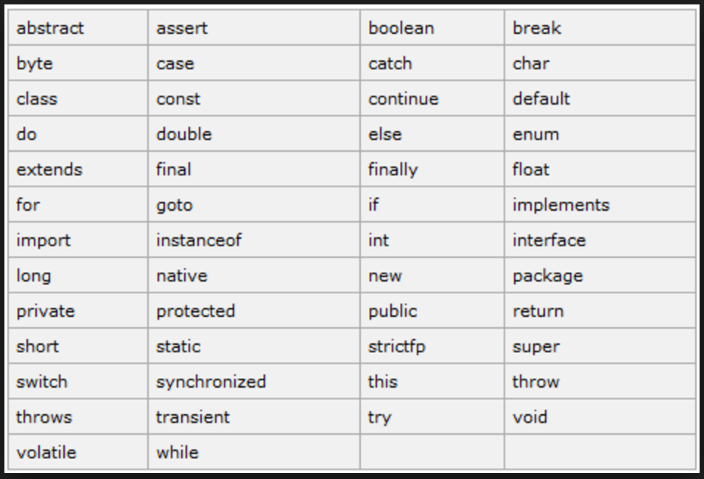
reserved words
In the Java programming language, a keyword is one of 50 reserved words that have a predefined meaning in the language; because of this, programmers cannot use keywords as names for variables, methods, classes, or as any other identifier

Slide 26
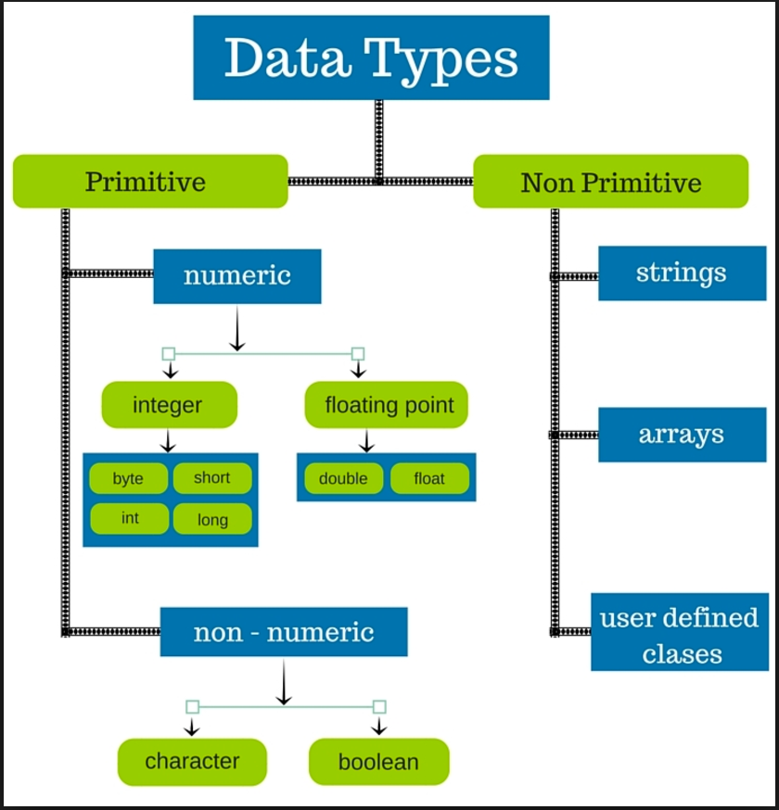
java data types
Based on Datatype of the variable, OS will allocate space to the variable and decide what can be stored in that space/memory
A data type has
Name (java key word, like int, String, boolean, etc)
Size (how much memory is used)
Default value
There are two data types available in Java
Primitive Data Types
Non Primitive Data Type (Reference/Object Data Types)
String

Slide 27
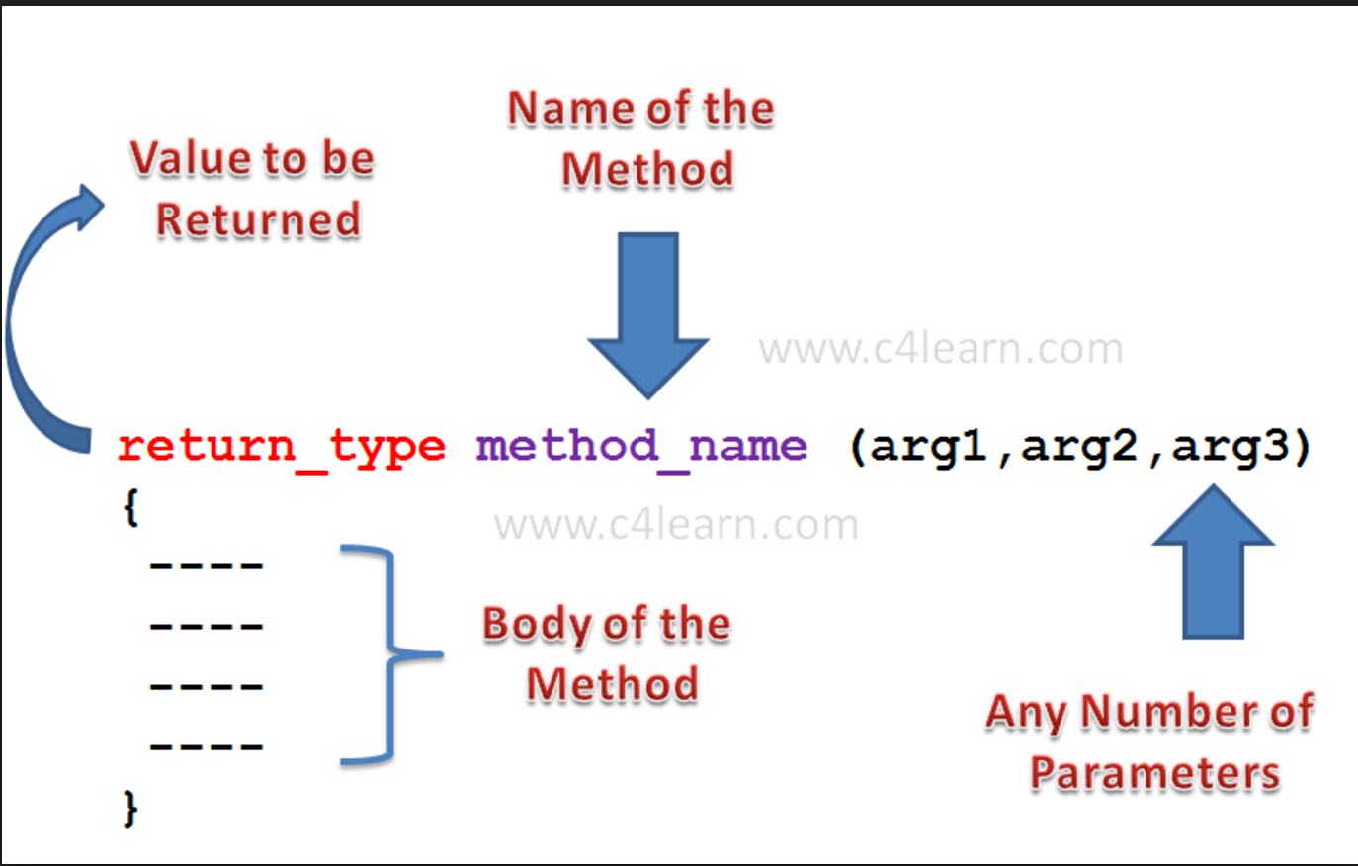
what is method?
Methods operate on internal state of an object and object to object communication is done by methods.
Method is a collection of statements which are grouped together to perform an action/operation.
Method can be invoked in program at any time just by calling its name.
Method can be:
Predefined : which is already defined by java, stored in java library. For e.g. System.out.println())
User defined: which is defined by you/programmer
1. With Return type With Parameters
2. With Return type, No Parameters
3. No Return type, With Parameters
4. No Return type, No Parameters

